Slide 1
2024 Spring Pattern Recognition
Homework 4 Announcement
Release Date: 2024/05/22 12:00
Notes:
‹#›

Slide 2
Homework 4
Deadline: 23:59, Jun. 12th (Wed), 2024
Kaggle and Report (70%): Participat in the Kaggle competition and write reports.
Competition (50%): Get good score.
Report (20%): Description and implementation related to your method.
Handwritten Questions (30%): Answer questions about deep learning.
Answer the questions in the report.
You must use the template and in digital-typed (no handwritten scan)
In English

Slide 3
Links
Questions and Report template
Link to Kaggle
Notes:
Here are some links about this assignment, and these links are on E3 system too.

Slide 4
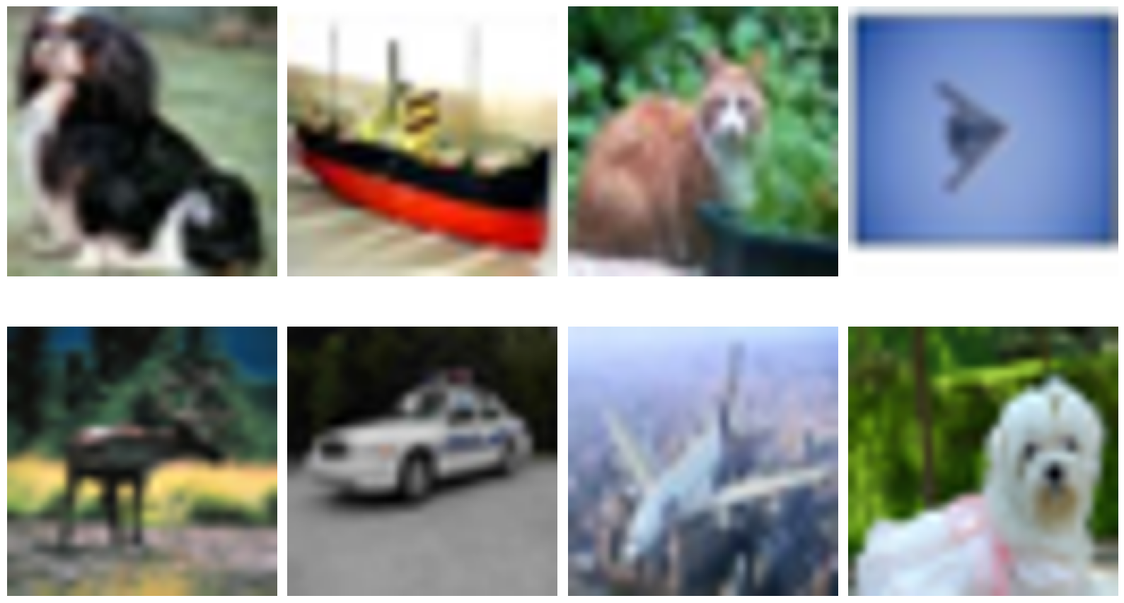
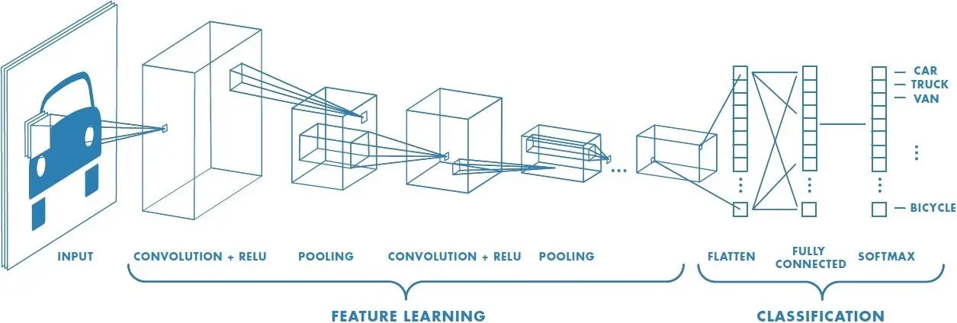
Convolutional Neural Networks for Bag Classification
We hide some target image inside a bag (seqence) of image, FIND IT OUT!
Positive if a bag contains at least one target, otherwise negative.
Hint
Multiple Instance Learning
Extract features from images first then classify.
Positive
Negative

Slide 5
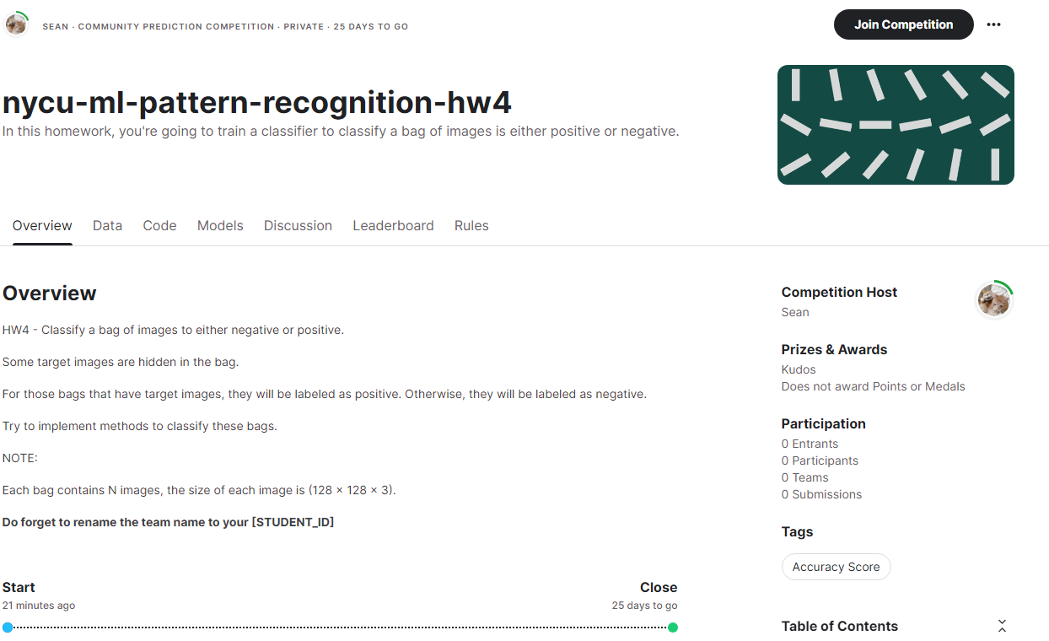
Join the Competition
Link

Slide 6
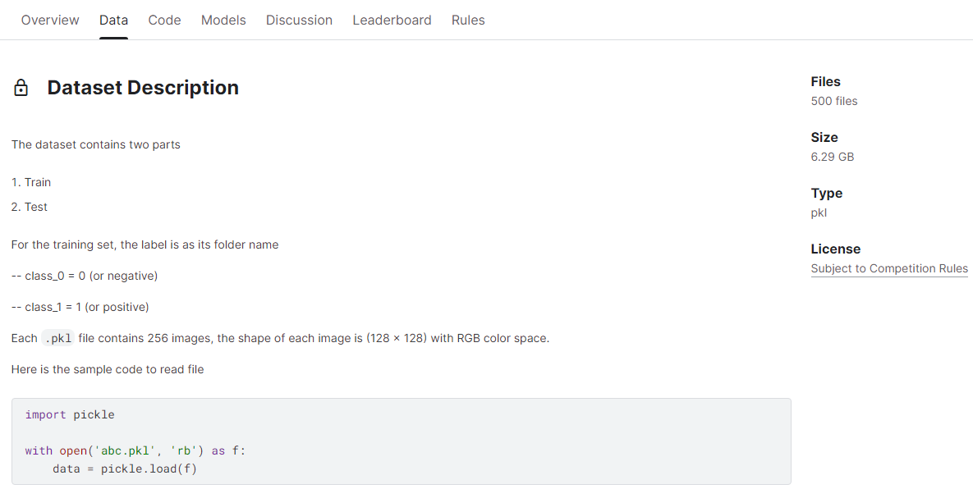
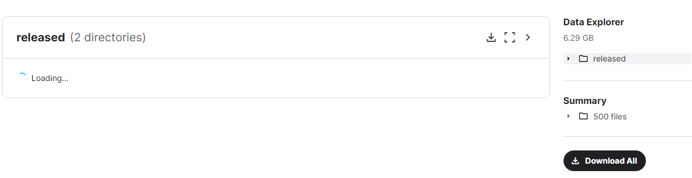
Download the Dataset

Slide 7
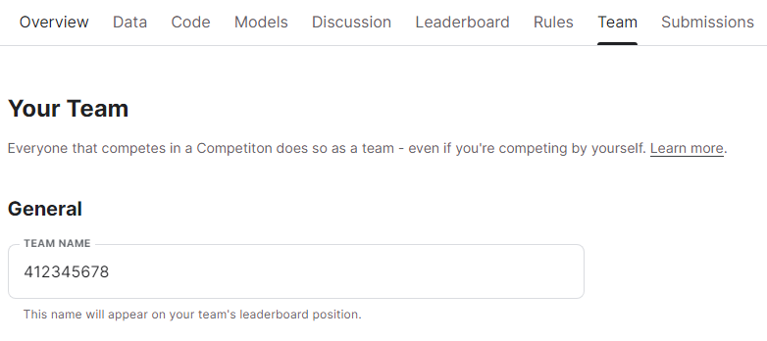
Set the Team Name
You must set your team name as your student ID.

Slide 8
Competition Rules
You are allowed to use any open-source resources/libraries but you must specify them in the report.
model architecture (ex: ResNet, ViT, etc. )
pre-trained weights (ex: ImageNet)
The only rule is that you have to train (finetune) your model by yourself!

Slide 9
Grading Criteria – Performance (50%)
Public leaderboard
For you as a reference (similar distribution to the private)
Private leaderboard
(25%) Baseline: accuracy >= 0.76 (Weak baseline)
(25%) Compete with your classmates
Tie rule: less submissions rank first
accuracy
0
0.76
best accuracy
point
0
25%
25%+25%
linear interpolation
linear interpolation

Slide 10
Grading Criteria – Report (20%)
Implementation details (10%)
Model architecture & hyperparameters (5%)
Training strategy (5%)
Experimental results (10%)
Evaluation metrics and learning curve (5%)
Ablation Study (5%)
To prevent submission counts that affect final rank, you can run ablations on individual validation set split from training set by yourself.

Slide 11
Numpy & PyTorch
Numpy Tutorial: Link
PyTorch Tutorial: Link
Free to use any modules and functions
Notes:
As previously mentioned, you will be implementing linear regression using only NumPy. NumPy is a powerful Python library that supports a wide range of array operations. We recommend that you have a basic understanding of NumPy before getting started. For instance, when performing element-wise multiplication, avoid writing code like this and instead utilize NumPy's multiplication function. Similarly, if you need to calculate element-wise square roots, there's no need to use the math library; simply use NumPy's numpy.sqrt() function.

Slide 12
Environment
Python version: 3.9 or higher
If you have a GPU
Conda
Miniconda
virtualenv
…
If you don’t have a GPU
Google Colab

Slide 13
Handwritten Questions (30%)
2-1 (10%)
Why Sigmoid or Tanh is not preferred to be used as the activation function in the hidden layer of the neural network? Please answer in detail.
2-2 (10%)
What is overfitting? Please provide at least three techniques with explanation to overcome this issue.

Slide 14
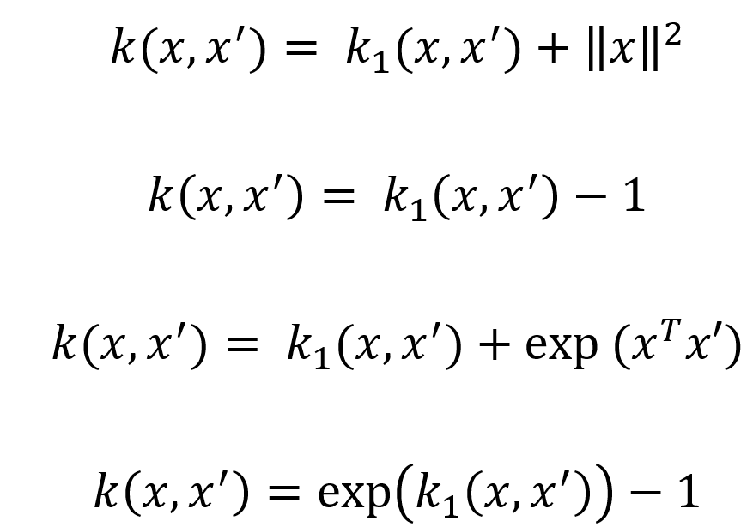
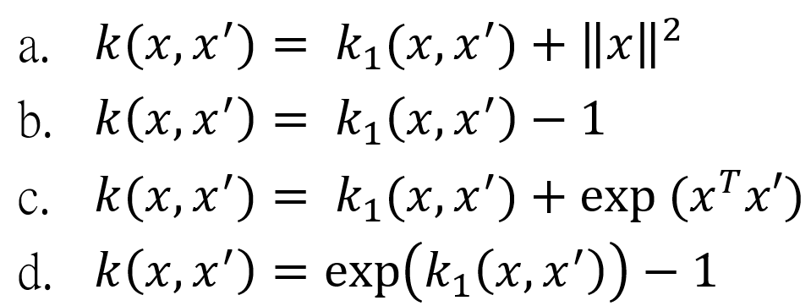
Handwritten Questions (30%)
2-3 (10%)
Given a valid kernel ,prove that the following proposed functions are or are not valid kernels. If one is not a valid kernel, give an example of that the corresponding K is not positive semidefinite and show its eigenvalues.
(reference: page 15 of 6.kernel_method.pdf)

Slide 15
Report
Please follow the report template format. (-5pts if not use the template)
Link
Notes:
About the report, please follow the report template format.

Slide 16
Submission
Compress your code and report into a .zip file and submit it to E3.
Report should be written in English. (-5 pts if not English)
<STUDENT ID>_HW4.zip
[YOUR CODE] (Make sure it is well-organized and can be executed)
Training code, Inference code, README, etc (README should contains how to setup your env and run the code)
Model weights: <STUDENT ID>_weight.txt (which contains a link to your google drive & ensure the permission is granted)
<STUDENT ID>_HW4.pdf (NO .doc, .docx or others format)
Don’t put the data (e.g. train.csv / test.csv) and model weights into submission file
-10 pts if you put the wrong things into zip file
Notes:
About submission, you have to Compress your code and report into a .zip file and submit it on E3. You should name your files correctly.

Slide 17
Kaggle Submission Reproduction
Your inference file should be able to reproduce your kaggle submission.
You will load the model in your inference file (with the model weights you provide) and then generate your kaggle submission file.
For python file (inference.py)
It will be checked on our lab’s servers. (NVidia 2080Ti, cuda 11.3)
Please provide a environment setup instruction which can help us quickly rebuild your environment and accurately reproduce your results.
For jupyter notebook file (inference.ipynb)
It will be checked on Google Colab.
Please include the necessary pip install instructions in the first cell.

Slide 18

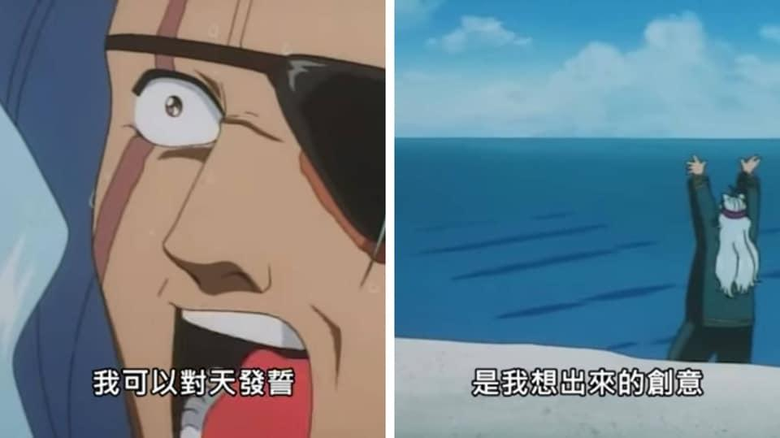
Other rules
Late Policy: No Delay allowed this time. (delayed, a.k.a. submission closed)
You will get 0 pts on HW4
No Plagiarism: You should complete the assignment by yourself. Students engaged in plagiarism will be penalized heavily. Super serious penalty.
0pt for the assignment or failed this course, etc
Report to academic integrity office

Slide 19

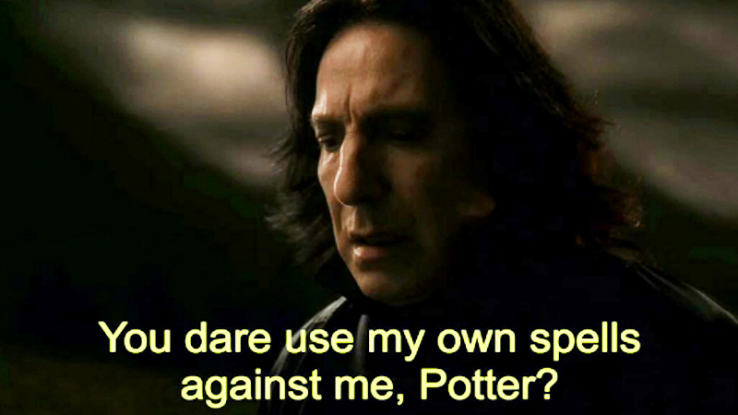
AI-Assistant
Not recommended but no forbidden
Copy-and-Paste answers from the AI-Assiant will be seen as Plagiarism
However, you can have your own answer first then rephrase it by AI-Assiant.
Some questions might be parts of final exam, make sure you understand the concept

Slide 20
FAQs
If you have other questions, ask on E3 forum first! We will reply as soon as possible.
If the E3 discussion area still have issues, feel free to write email to TAs (And remember to cc all TAs).

Slide 21
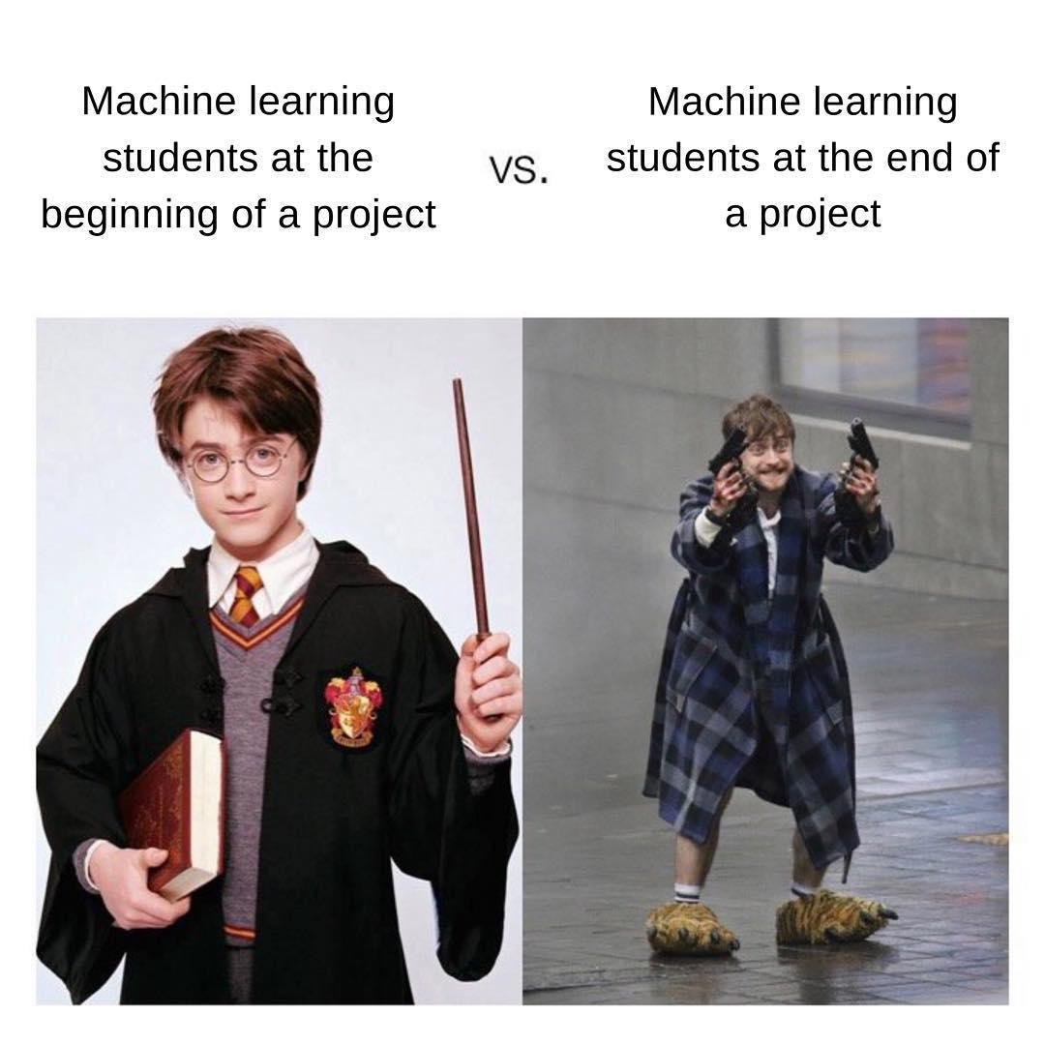
Have Fun!

